Slide 1

GIT IT RIGHT!
A Hands-On Workshop on Git & GitHub for Beginners
Speaker: Vinayak Sharma, Samsung Research

Slide 2


ABOUT ME
Final year B-Tech in CS & AI @ IIIT-Delhi
SWE intern, Samsung Research
Undergraduate researcher @ Network and Sytems Security Lab, IIIT-Delhi
Open Source maintainer @ MemGPT

Slide 3
VERSION CONTROL SYSTEMS
#Demonstration: File Comparison in Large Codebases
Why Use VCS ?
A Version Control System tracks changes to files over time.
Enables collaboration, recovery, and history tracking.

Slide 4

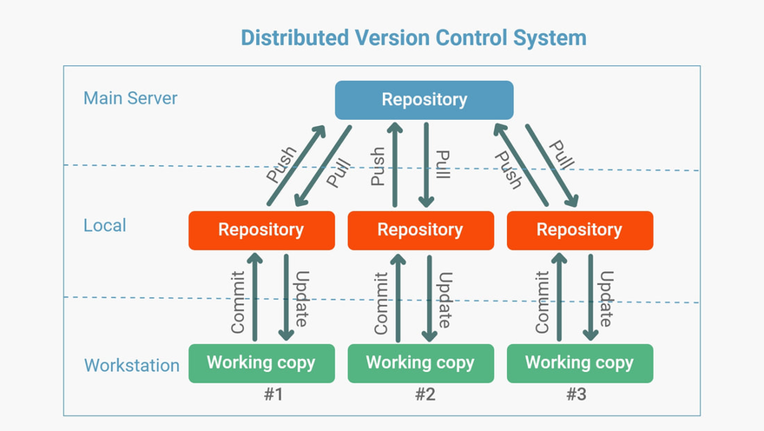
GIT
Distributed VCS
Ideal for large projects
Industry standard

Slide 5
GIT
Advantages:
Distributed VCS: Every developer has full history
Fast: Local operations don’t need internet or server access
Integrity: SHA-1 hashing ensures file integrity and history accuracy

Slide 6
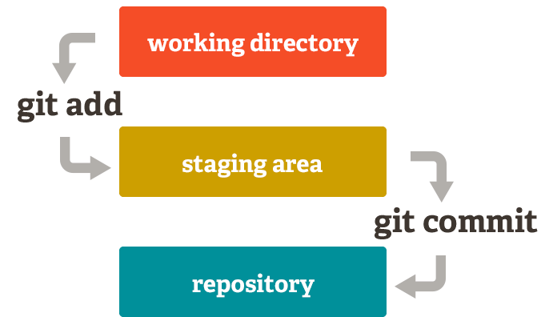
Making Changes
Working Directory – where you make changes.
Staging Area – where you prepare changes for the next commit.
Repository – where committed snapshots are stored permanently.
Think of staging like packing items into a box before sealing and shipping it.

Slide 7
BASIC COMMANDS
Start a Repository: git init
Add & Commit Files: git add filename
Commit Files: git commit -m "Message"
Check Status and History: git status ; git log
Compare Changes: git diff
#Demonstration: Live usage

Slide 8

GITHUB
Microsoft-Owned Cloud Platform
Large developer community
Student developer pack (more towards the end...)

Slide 9
GITHUB
Collaboration: Teams can work on the same repo from anywhere.
Social Coding: Follow developers, star repositories, and fork codebases.
Integrated DevOps: Built-in Actions for CI/CD.
#Demonstration: Github navigation; new repo

Slide 10
GITHUB
#Demonstration: Integration of local and remote repository
#Demonstration: Pull, push commands ; ReadMe
Good Practices:
Maintain a README.md
Write Descriptive Commit Messages
Protect Main Branch, ie stable, production-ready branch

Slide 11
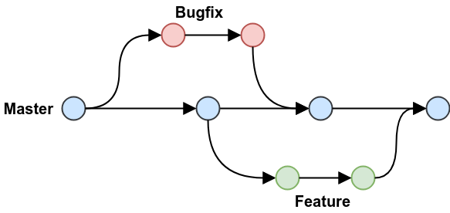
BRANCHES
Isolate Features: Work on new features/ bug fixes without affecting the main codebase.
Collaboration: Multiple developers can work on separate branches
#Demonstration: new branch, checkout

Slide 12
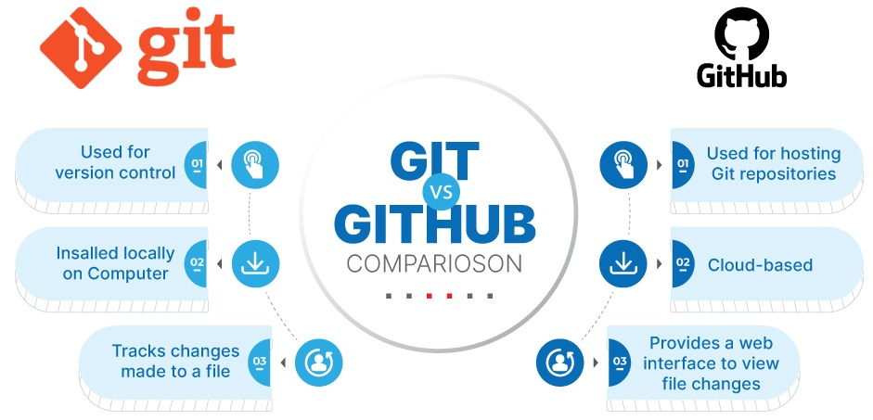
GIT VS GITHUB

Slide 13
REAL INDUSTRY REPOS
#Demonstration(pytorch): About, Insights

Slide 14
MY OPEN SOURCE WORK
#Demonstration(letta-ai): Issues, pull requests, fork

Slide 15
STUDENT DEVELOPER PACK
Must be a student: You need a valid academic email
Active GitHub account
Verification: GitHub will verify your status

Slide 16
BENEFITS
GitHub Pro: Unlimited private repositories, GitHub Actions, advanced code insights
Cloud Hosting & Storage Credits: Azure, DigitalOcean, Google Cloud
Learning Resources & Courses
Github Copilot
#Demonstration: Copilot demo

Slide 17
REFERENCES
https://training.github.com/downloads/github-git-cheat-sheet.pdf
https://githubtraining.github.io/training-manual/book.pdf
https://www.interviewbit.com/blog/git-vs-github/
https://www.shiksha.com/online-courses/articles/git-vs-github-whats-the-difference/

Slide 18
THANK YOU

